Slide 1
Self-driving cars
Macy Nelson 4B

Slide 2
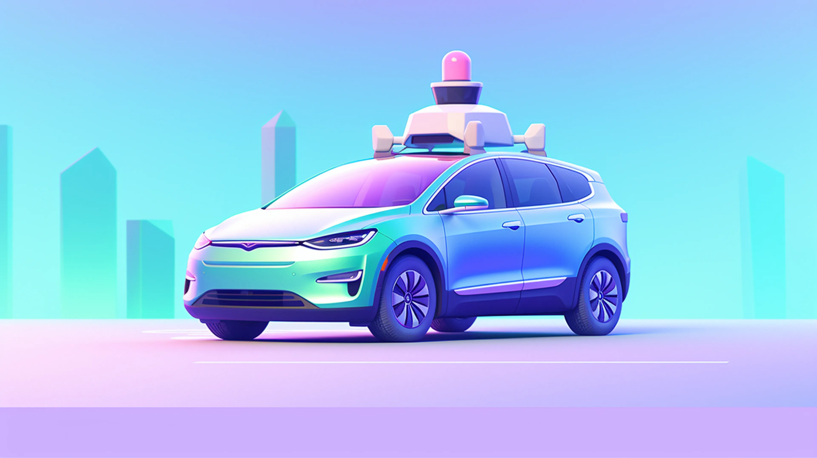
Overview
History
Plan and implantation
Upsides/Pros
Downsides/Cons
Summary
Sources

Slide 3
History
Conceived in the 1980’s by the German Ernst Dickmanns.
First self driving car was created in 1987, on the first drive it traveled through traffic free streets at 63 mph.
Notes:
In the 1980s, pop-culture icons like the Terminator and Knight Rider propagated the concept of fully autonomous robots and cars. In the decades since, we’ve accepted the concept of autonomous vehicles as a coming reality, but they’ve still been limited to Sci-Fi.

Slide 4
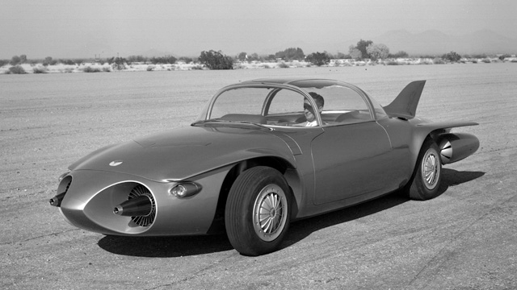
First Self Driving Car

Slide 5
Plan and Implantation
Self driving cars will have a negative impact on driving-related jobs in the road transportation industry.
Notes:
Self-driving cars would have the same impact on the auto industry that the smartphone had on telecommunication: massive and unpredictable.

Slide 6
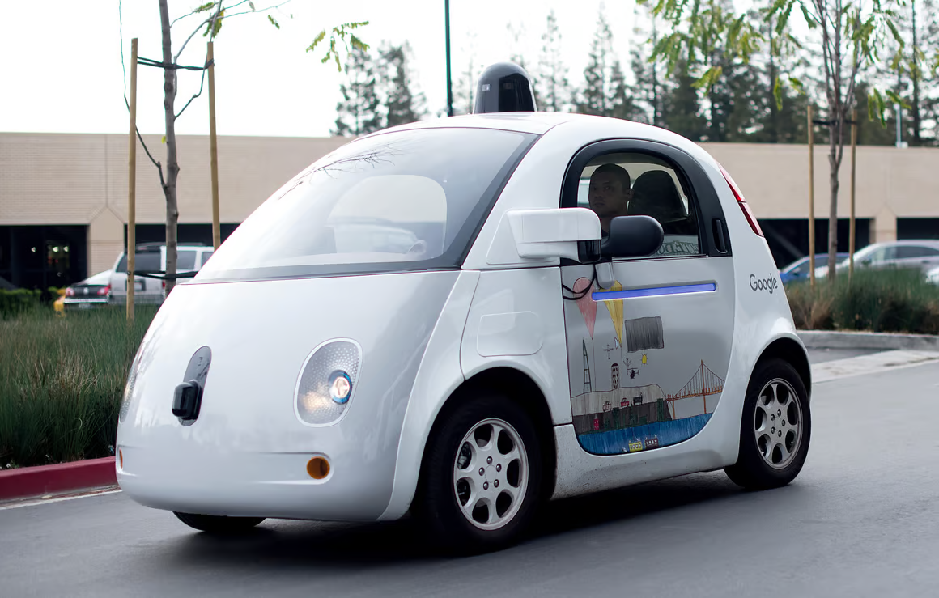
Upsides/Pros
Efficient fuel handling
Reduced CO2 emissions
Transportation accessibility
Better land use.
Notes:
Less congestion means less commuting time. In the future, AVs could offer the convenience of dropping vehicle occupants at their destination, whether an airport or shopping mall, while the vehicle parks itself.

Slide 7
Downsides/Cons
Job losses
Expensive
Privacy concerns
Prone to hacking
Notes:
Self-Driving cars would cause many job losses for people who work in jobs that involve driving others. They would also be much more expensive than regular cars. These cars could also get hacked and be dangerous.

Slide 8
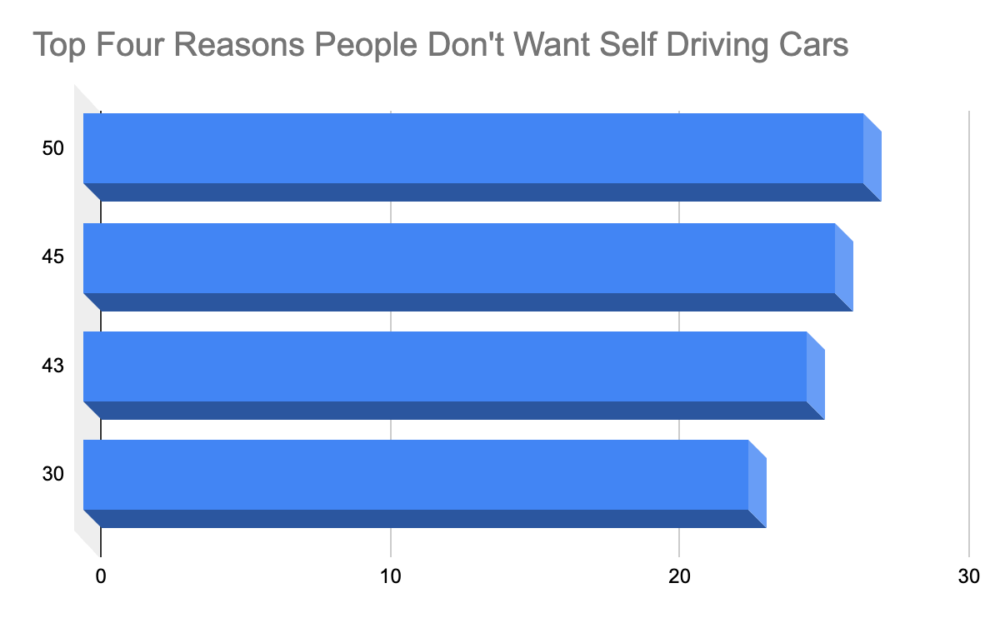
Wouldn’t feel safe
Want to be in control at all times
Don’t want the car to make mistakes
Enjoys driving

Slide 9
Summary
I think the self-driving car is a interesting and innovative thought but in reality it is very dangerous and causes people to lose jobs. I also think that learning to drive is a big part of the human life, and by using self-driving cars we would be taking away this experience from future generations.

Slide 10
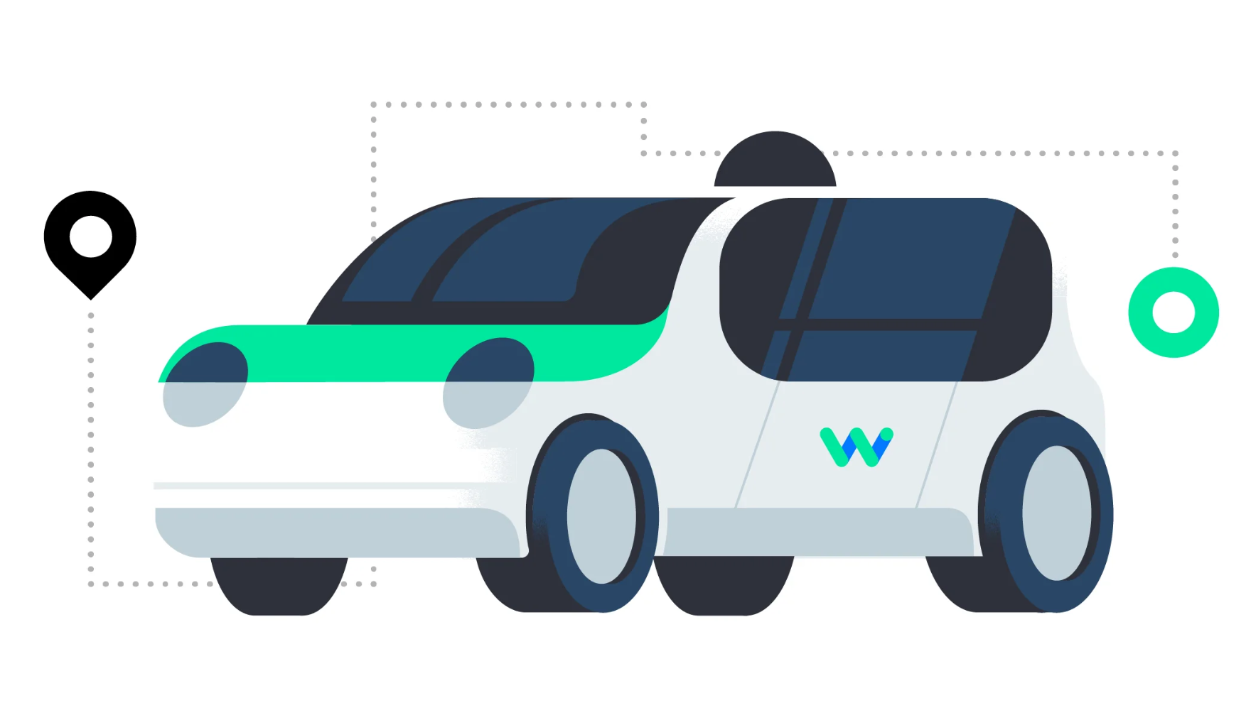
Sources
History of Self-Driving Cars
Benefits To Self-Driving Cars

